Slide 1
Board of County Commissioners
Regular Meeting
January 19, 2023
5:30 p.m.
Columbia County School Board Administrative Complex

Slide 2
FY 22/23 Capital Projects Grant Funded
Capital Project | Est. Project Cost | Current Expended | Remaining Bal.
Eastside Sewer Expansion | $13,200,000 | $703,478 | $12,496,522
Ellisville Sewer Expansion | $1,545,000 | $85,858 | $1,459,142
Legis Appropriation Rail | $3,750,000 | $2,994,594 | $755,406
NFMIP Water Treatment Pl | $ | $ | $
Ellisville/Ft. White Water | $7,200,000 | $998,506 | $6,201,494
SR247- Cannon Creek | $2,560,000 | $0 | $2,560,000
Cypress Lake/ Charles | $2,700,000 | $388,626 | $2,311,374
Parnell Hills | $3,614,119 | $126,262 | $3,487,857
Hi-Dry Acres | $4,762,258 | $183,043 | $4,579,215
Queen/Chambria/Winfield | $2,475,000 | $167,063 | $2,307,937
Birley Road | $2,982,000 | $39,045 | $2,942,955
CR 6 | $2,640,000 | $43,918 | $2,596,082

Slide 3
FY 22/23 Capital Projects Grant Funded
Capital Project | Est. Project Cost | Current Expended | Remaining Bal.
GRAND TOTAL | $ 47,428,377 | $ 5,730,393 | $41,697,984

Slide 4
FY 22/23 Capital Projects County Funded
Capital Project | Est. Project Cost | Current Expended | Remaining Bal.
Richardson Generator | $171,400 | $33,773 | $137,627
Franklin Street Tower | $15,000 | $0 | $15,000
IT Fire Suppression | $87,000 | $9,532 | $76,467
Richardson Outdoor Lights | $280,000 | $0 | $280,000
Generator Monitoring | $12,500 | $0 | $12,500
Five Point Restrooms | $98,000 | $78,206 | $7,054
River Rise Boat Ramp | $101,835 | $0 | $101,835
Field Laser Grading | $40,000 | $40,000 | $0
Bridges on Bike Trail (2) | $63,000 | $0 | $63,000
TDC Billboard Project | $80,000 | $0 | $80,000

Slide 5
FY 22/23 Capital Projects County Funded
Capital Project | Est. Project Cost | Current Expended | Remaining Bal.
Lake City Animal Shelter | $70,000 | $0 | $70,000
Petroleum Cleanup | $32,399 | $3,518 | $28,881
Station 51 Expansion | $200,000 | $17,631 | $182,368
Jail Admin Design | $400,000 | $0 | $400,000
Traffic Ops Building | $250,000 | $0 | $250,000
Animal Control | $300,000 | $0 | $300,000
Parking Lot- Southside | $603,460 | $39,508 | $563,951
C.Club/CR 252 Signal | $150,000 | $0 | $150,000
Mayo Road | $260,000 | $147,662 | $112,338
Double Run | $232,000 | $29,695 | $202,305
English St/LM Aaron Dr. | $139,000 | $159,728 | $(20,728)

Slide 6
FY 22/23 Capital Projects County Funded
Capital Project | Est. Project Cost | Current Expended | Remaining Bal.
Old Wire | $1,275,060 | $0 | $1,275,060
SE Academic | $400,000 | $0 | $400,000
GRAND TOTAL | $5,260,654 | $559,253 | $4,687,658

Slide 7
Change Order #2.1 - Ellisville WWTP Expansion – SGS Contracting Services, Inc.- $39,832.37
The CO#2.1 (and Backup) is for the purpose of including provisions in the new Treatment Train No. 2 installed under this project to facilitate accommodation of required process modifications in a future expansion phase to achieve a lower total nitrogen limit.
CO#2.1 is for an additive increase in the amount of $39,832.37 and an increase in 31 calendar days to the contract time.
Recommended Motion: Ratify the approval of CO#2.1 with SGS Contracting Services, Inc.in the amount of $39,832.37 and execute Exhibit H.

Slide 8
2023 Annual Resurfacing Projects District 3
Emerald Lakes Subdivision Roadways
NW Gray Gln 200’
NW Harwell Ct 800’
NW Kelly Lake Ct 1000’
NW Gaelic Ct 670’
NW Zack Dr 3850’
NW Silverleaf Ln 460’
NW Emerald Lake Dr 1160’
NW Heritage Dr 1540’
The proposed construction will consist of milling and surfacing. The total length is 9680’ and the estimated cost is $800,000.00

Slide 9
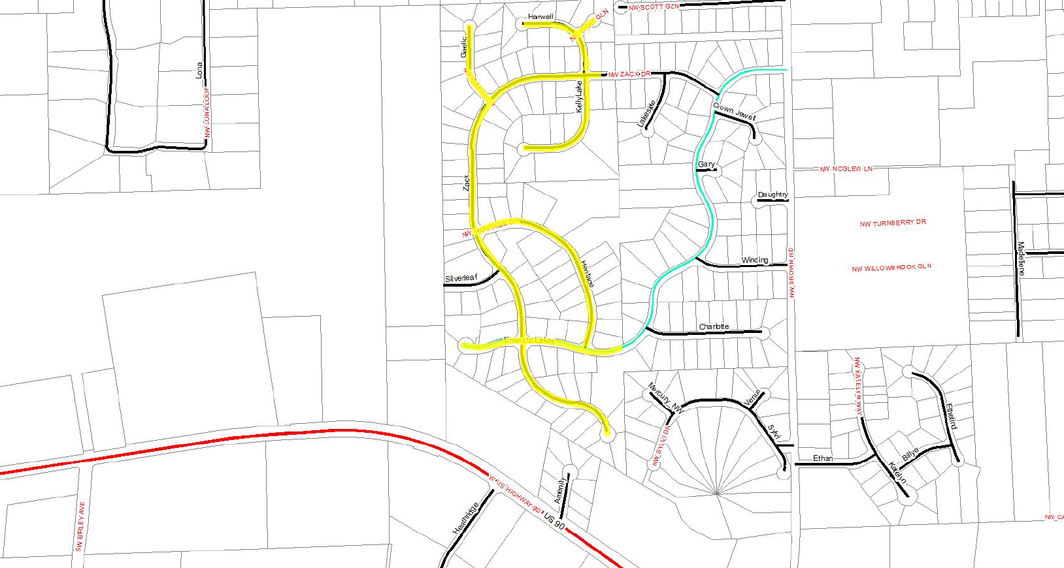
2023 Annual Resurfacing Projects Emerald Lakes Resurfacing

Slide 10
2023 Annual Resurfacing Projects District 3
Saddle Ridge Subdivision
SW Melon Ct 950’
Kensington Subdivision
SW Royal Ct 1200’
Due to pavement failure and the probability of base and subgrade failure, the proposed construction will consist of full depth reclamation. The total length is 9680’ and the estimated cost is $400,000.00

Slide 11
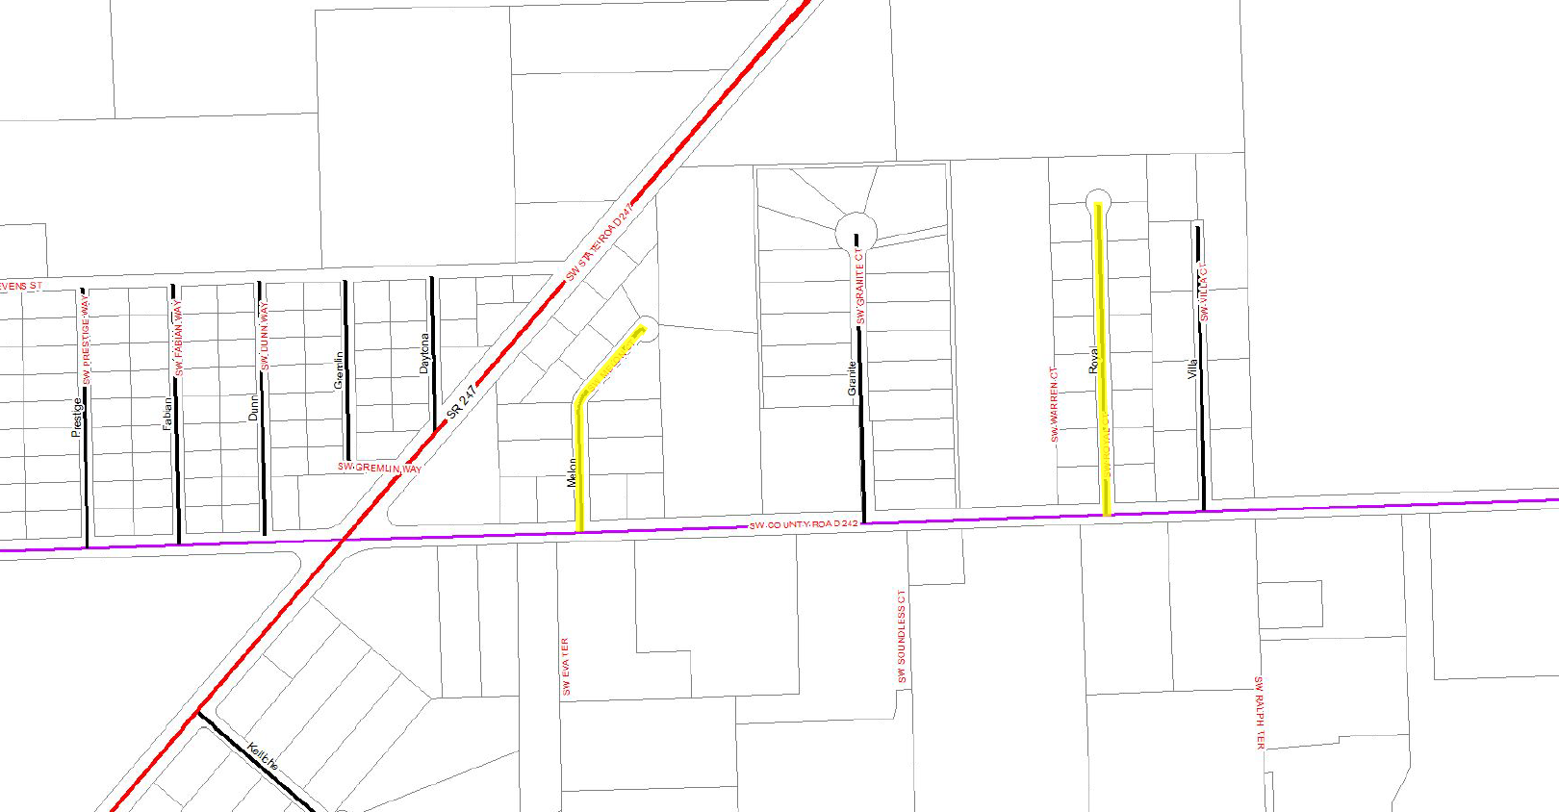
2023 Annual Resurfacing Projects SW Melon Ct and SW Royal Ct

Slide 12
2023 Annual Resurfacing Projects District 3
Recommended Motion: Approve Annual Resurfacing Projects for District 3 in the amount of $1,200,000 to be funded from 303-8082-541.30-46.

Slide 13
Bid No. 2023-A Traffic Stripe Painting
The County received two (2) bids for the above referenced solicitation.
Recommended Motion: Award Bid No. 2023-A to the low bidder, Jenkins Painting Inc. in the amount of $487,894.24 effective February 1, 2023 for a one-year period with an option to renew annually for an additional two-year period.
Company Name | Total Bid Amount | Min. Daily Paint Crew Charge
Emerald Coast Striping | $568,074.98 | $1,500
Jenkins Painting Inc. | $487,894.24 | $1,000

Slide 14
Bid No. 2022-JJ - Urban Mowing
The County received three (3) bids for the above referenced solicitation.
Recommended Motion: Award Bid No. 2022-JJ to the lowest qualified bidder, Creative Concepts Home & Landscaping Solutions Inc. in the amount of $24,802 per cycle with an annual cost totaling $198,416 effective April 1, 2023 for a one-year period with an option to renew annually for an additional two-year period.
Company Name | Price Per Cycle
Aero Groundtek LLC. | $33,200
Creative Concepts | $24,802
Green Maint. & Clean | $34,444

Slide 15
Board of County Commissioners
Regular Meeting
January 17, 2023
5:30 PM
Columbia County School Board Administrative Complex

Slide 16
Resolution No. 2023-02 Loan Agreement
The County has executed two State-Funded Grant Agreements with the Florida Department of Transportation ("FDOT"), in the amount of $2,639,677 for the resurfacing of CR 6 and $2,982,488 for the resurfacing of SW Birley Road from CR 242 to CR 252.
The County will borrow $5,665,165 through the issuance of its Capital Improvement Revenue Note Series 2023 (the "Loan"). This represents $5,622,165 in expected FDOT Grant proceeds and $43,000 in costs of issuance.
The $5,665,165 loan is secured by non-ad valorem revenues with a 15-year maturity but is expected to be repaid from two approved FDOT grants dispersed quarterly between July 2023 and January 2027.
The loan is with First Federal Bank at an interest rate is 3.95%
Recommended Motion: Approve Resolution 2023-02 and authorize the execution of loan documents/

Slide 17
Resolution 2023R-01 - Purchase and Sale Agreement - Lake City Reporter Office Building
Purchase Price: $795,000
Size: 10,951 square feet with
6,800 square feet of finished office space
Appraisals: $800,000 and $873,000
Average of Appraisals: $836,000
Deposit: $10,000
Closing Date: 45 days
Post Closing Occupancy Agreement: 120 days
Roof Repair/Replacement: $81,705 to $196,761
Estimated Commercial Renovation Cost: $1,224,000
Closing Costs: up to $13,000
Estimated Utility Cost: $16,000 annually
County’s Existing Lease Costs: $104,686 annually ($58,710 and $45.976)

Slide 18
BA 23-24 Upgrade to Courthouse Security
The Sheriff has requested to use $27,855 in Forfeiture funds for improvements to the Courthouse security
An additional $27,855 of Court funds would be used to match the Forfeiture funds
Current system is older and replacement parts are unavailable.
Recommended Motion: Approve BA23-24
From: | To: | Amount:
126-0000-358.20-00 SEIZED PROPERTY/ | 126-8100-581.90-71 INTERFUND TRANSFERS OUT/CCSO COURTHOUSE SECURITY | $27,855
105-0000-381.91-21 INTERFUND TRANSFERS IN/FROM SHERIFF SPEC REV. FD | 105-1710-564.30-19 OPERATING EXPENDITURES/COURT INNOVATIONS | $27,855
105-8400-584.90-96 RESERVES/COURT INNOVATIONS RESERVE | 105-1710-564.30-19 OPERATING EXPENDITURES/COURT INNOVATIONS | $27,855

Slide 19
Annual Leave Lawrence Wilson
County Policy caps the accumulation of annual leave at 352 hours as of December 31
Lawrence Wilson has a position that requires him to be on call 24/7 which has prohibited him from using his annual leave
In December, he forfeited 101.52 hours of annual leave
The 101.52 hours of annual leave with benefits would equal approximately $4,910
In 2012, the Board approved similar leave pay for Pam David at the Landfill
Recommended Motion: Approve one time payment of forfeited leave for Lawrence Wilson

Slide 20
BA 23-25 Supervisor of Elections Reversion FY 2021-22
The Supervisor of Elections is submitting the Annual Financial Report and Reversion for FY 2021-2022 and will return of $64,644
The Supervisor of Elections requests the $64,644 be returned to her budget to update election equipment for future elections
Recommended Motion: Approve BA 23-25 and accept Annual Financial Report and Reversion
From: | To: | Amount:
001-8400-584.90-98 RESERVES/CASH BALANCE FORWARD | 001-8100-581.91-18 INTERFUND TRANSFERS OUT/SUPERVISOR OF ELECTIONS | $64,644.00

Slide 21
BA 23-30 EMS Grant Award
Columbia County Fire and Rescue has been awarded the EMS County Grant for $28,797
This budget amendment will allow the department to purchase EMS equipment including two Lucas devices that perform automatic chest compressions on patients
Recommended Motion: Approve BA 23-30
From: | To: | Amount:
102-0000-334.20-02 GRANT IN AID/EMS | 102-2614-526.30-64 OPERATING EXPENDITURES/NON-CAPITAL EQUIPMENT | $28,797

Slide 22
BA 23-31 Grant for Utility Software
At the 12/2/2022 meeting, the Commissioners accepted a grant from the Suwannee River Water Management District for a water meter replacement program
In addition, the Board approved the purchase of RosTech UMBS Utility Billing Software and Maintenance Agreement -- pending grant approval of the expense
In discussions with the SRWMD, the Utility Billing Software is not an eligible expense
Approval of this BA would authorize the use of a portion of the LATCF Grant for the purchase of the Utility Billing software and annual maintenance agreement from RosTech
Recommended Motion: Approve BA 23-31
From: | To: | Amount:
001-8400-584.90-98 RESERVES/CASH BALANCE FORWARD | 001-8100-581.91-45 INTERFUND TRANSFERS OUT/TO UTILITIES FUND | $40,000
405-0000-381.90-01 INTERFUND TRANSFERS IN/FROM GENERAL FUND | 405-3309-533.60-63 CAPITAL OUTLAY/INFRASTRUCTURE | $40,000

Slide 23
BA 23-26 Sheriff’s Federal Forfeiture Fund
The Sheriff is requesting $37,768 from the Sheriff's Federal Forfeiture Fund for drone equipment to assist in various search, tactical and crime scene operations and a replacement K9 unit
Recommended Motion: Approve BA 23-26
From: | To: | Amount:
126-0000-358.20-00 SEIZED PROPERTY/ | 126-8100-581.90-21 INTERFUND TRANSFERS OUT/SHERIFF LAW ENFORCEMENT | $37,768

Slide 24
Animal Control
The Sheriff’s Office has determined that they will not handle Animal Control
The Sheriff is returning $128,895 for the capital outlay budgeted for Animal Control services
The contract with LC Humane Society that expires at the end of the fiscal year
Construction of the new kennel facility has not started
Recommended Motion: Accept the letter from the Sheriff and authorize the County to proceed with other options to provide Animal Control Services

