Slide 1
Board of County Commissioners
Budget Workshop
Central Communications

Slide 2
FY 2022 Budget Request Changes
Additions to Central Communications current budget are reflected in annual contractual services @ $82,600
Vertiv Battery Backup Preventative Maintenance Contract | $2,500
Changes in recurring cost for two tower sites that were not previously budgeted in prior FY.
Forest and Borrow Pit towers utilities | $4,800
FPL and Duke Energy average $200/month each
Annual Radio Management Service Agreement | $29,000
Equipment refresh/upgrades, advance repair/replacement and cloud services

Slide 3
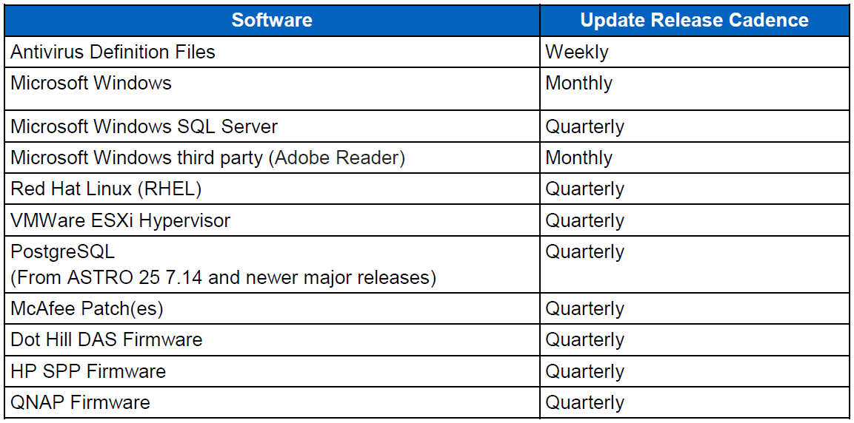
FY 2022 Budget Request Changes cont
Radio Network Security Update Service (SUS) and Motorola Technical Notices (MTN) (Budgetary quote | $42,000 annually)
ASTRO 25 SUS includes pretested security updated for the software listed:

Slide 4
FY 2022 Repair and Maintenance
Additions to Central Communications Repair and Maintenance budget to cover two additional generators maintenance | @ $4,300
Changes in recurring cost for two towers that were not previously budgeted in prior FY.
Forest and Borrow Pit towers generator Preventive Maintenance | $4,300
Minor PM/quarterly PM @ $350 each | Major PM/annual PM @ $750 each

Slide 5
FY 2022 Capital Projects and Equipment
Central Communication Capital Projects and Equipment | $221,336.46
Replace Franklin St. Tower Generator | $15,000
Generator installed 1999 and has multiple issues
Network Service Monitor Upgrade (Budgetary Quote | $25,000)
CUMMINS PowerCommand remote monitoring and alerting ($12,500)
Monitor/control/alerting fuel levels, coolant temp, oil temp remote start/shutdown
BARD Air Conditioning Lead-Lag HVAC Controllers | $17,404.00
Monitor/control/alerting room temp, compressor run times, air flow and failures
Distributed Antenna System (Contract Quote | $146,632.46)
Distributed Antenna System (DAS) improves coverage in the Courthouse and Jail in areas where outside signal strength doesn’t penetrate.

Slide 6
FY 2022 Capital Projects and Equipment cont
Distributed Antenna System continued
OCG Project Management Cost based off previous consulting contract of 30 hours at $160 per hour rate | $4,800
Florida Statute 633.202 state that certain buildings shall have a degree of public safety coverage.

Slide 7
FY 2022 Central Communication Revenue
Secondary User Invoice with 2.6% CPI increase
City of Lake City | 165 active subscribers @ $10.26/subscriber (year 2) = $20,314.80
Century Ambulance | 17 active subscribers @ $41.04/subscriber (year 2) = $8,372.16
Veterans Hospital | 2 active subscribers @ $20.00/subscriber (year 1) = $480.00
Excelsior Ambulance | 1 active subscribers @ $10.26/subscriber (year 2) = $123.12
Total Secondary User Fees to Invoice: $29,290.08
Central Communications request Cross-Accounting between Departments and Elected Officials to assist in offsetting annual network maintenance and subscriptions.

Slide 8
Employees
Position Title Number of employees
Radio Technician 1

Slide 9
2021 Budget Request
Central Communications Budget Worksheet
 | FY 2020-21 Budget | Additional Requested | Memo#
OPERATING EXPENDITURES
001-2620-525.30-31 PROFESSIONAL SERVICES | $0.00 | $4,800.00 | 5
001-2620-525.30-34 CONTRACTUAL SERVICES | $160,000.00 | $82,600.00 | 1
001-2620-525.30-40 TRAVEL & PER DIEM | $1,000.00 | $1,000.00 | 2
001-2620-525.30-41 COMMUNICATIONS | $3,500.00 | $0.00
001-2620-525.30-43 UTILITIES | $17,000.00 | $4,800.00 | 3
001-2620-525.30-44 RENTAL/LEASES | $0.00 | $0.00
001-2620-525.30-46 REPAIRS & MAINTENANCE | $53,000.00 | $4,300.00 | 4
001-2620-525.30-49 OTHER CHARGES | $1,000.00 | $0.00
001-2620-525.30-51 OFFICE SUPPLIES | $1,000.00 | $0.00
001-2620-525.30-52 OPERATING SUPPLIES | $0.00 | $0.00
001-2620-525.30-54 SUBSCRIPTION & DUES | $500.00 | $0.00
001-2620-525.30-55 TRAINING | $0.00 | $0.00
001-2620-525.30-56 GAS & OIL | $1,500.00 | $0.00
001-2620-525.30-64 CAPITAL EQUIPMENT |  | $216,536.46 | 5
 | $238,500.00 | $314,036.46

Slide 10
Five Year Plan
Maintain communications system with minimal downtime.
Work with surrounding counties to extend their coverage and create a regional system at no cost to Columbia County.

