Slide 1
Board of County Commissioners
April 20, 2023
5:30 PM
Columbia County School Board Administrative Complex

Slide 2
DUDA EXPANSION CPA 0243
CPA 2043 IS AN AMENDMENT TO THE COMPREHENSIVE PLAN TO EXPAND THE DESIGNATED URBAN DEVELOPMENT AREA TO INCLUDE ADDITIONAL USES. LANDS ARE LOCATED NEAR THE INTERCHANGE OF SR 41 AND I-10 IN UNINCORPORATED COLUMBIA COUNTY. THE SUBJECT PROPERTY INCLUDES LANDS BOTH TO THE EAST AND WEST OF SR 41 AND NORTH AND SOUTH OF I-10.
THE CURRENT DUDA LAND USE CONSISTS OF THREE (3) ZONING CATEGORIES FOR A TOTAL OF 4,147 ACRES:
A-3---3,637 ACRES (87.7% OF SITE)
MIXED USE---312 ACRES (7.5% OF SITE)
PUBLIC---198 ACRES (4.8% OF SITE)

Slide 3
DUDA EXPANSION
THE PROPOSED DUDA LAND USE WOULD CONSIST OF SIX (6) ZONING CATEGORIES:
COMMERCIAL HIGHWAY INTERCHANGE---21 ACRES (.5% OF SITE)
Tourist oriented facilities,
Retail outlets,
Truck stops,
Light manufacturing, assembling, processing, packaging or fabricating in completely enclosed building and
Facilities for the storage and distribution of foods and products including wholesale activity.
INDUSTRIAL---1,572 ACRES (38% OF SITE)
Manufacturing, assembly processing or storage of products,
Public, charter and private schools teaching industrial arts curriculum, and
Off-site signs, truck stops and automotive service stations may be approved as Special Exceptions subject to an intensity of less than or equal to 1.0 floor area ratio.

Slide 4
DUDA EXPANSION
LIGHT INDUSTRIAL---393 ACRES (9.5% OF SITE)
Storage, warehousing, wholesaling and distribution,
Light manufacturing (assembling or fabricating) and processing in completely enclosed facilities,
Public, charter and private schools teaching industrial arts curriculum, and
Off-site signs and other similar uses may be approved as Special Exceptions subject to an intensity of less than or equal to 1.0 floor area ratio.
PUBLIC LAND USE---300 ACRES (7.2% OF SITE)
Sewer facilities,
Solid waste facilities,
Drainage facilities,
Potable water facilities,
Public health facilities, and
Educational uses.

Slide 5
DUDA EXPANSION
RESIDENTIAL LAND USE- 1,861 ACRES (44.8% OF SITE)
Dwelling units at very low (1/acre), and low (2/acre),
PRD notwithstanding very low and low density with lots greater than 1 acre is size shall be limited to 25 such lots, and
Other uses may be approved as special exceptions and be subject to an intensity of 1.0 floor area ratio.

Slide 6
DUDA EXPANSION
EFFECTS OF DUDA EXPANSION
1. Agriculture 3 zoning will remain at 3,637 acres,
2. Mixed Use District of 312 acres will be eliminated,
3. Public will be increased to from 198 acres to 300 acres,
4. Commercial Highway Interchange of 21 acres will be added,
5. Industrial of 1,572 acres will be added,
6. Light Industrial of 393 acres will be added,
7. Residential – low density (2/acre) of 21 acres will be added, and
8. Residential – very low density (1/acre) of 1,840 acres will be added.
TOTAL 4,147 Acres

Slide 7
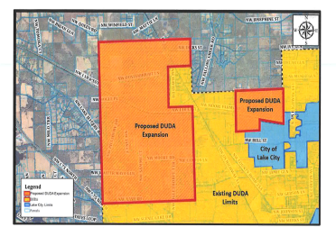
DUDA EXPANSION
The existing DUDA area is abutting subject properties on several sides and along several miles of commonly-shared property lines. The following slide illustrates the existing location of the DUDA limits (in yellow) and the proposed expansion ( in orange.)

Slide 8
DUDA EXPANSION
The proposed amendments to the Future Land Use Map will result in a change of permitted densities, intensities and overall land use entitlements in a portion of the County that is in close proximity to the Interstate 10/ State Road 41 interchange that has been identified by Columbia County as an area that is strategically located and appropriate for future economic development.

Slide 9
Board of County Commissioners
Regular Meeting
April 20, 2023
5:30 p.m.
Columbia County School Board Administrative Complex

Slide 10
Trail Agreement - Columbia County/Duke Energy Florida
Trail Agreement between the County and Duke Energy as it relates to the installation of the trail from U.S. Hwy 27 at Ichetucknee River to Suwannee County.
Revisions were made to Paragraph 19 and 20 in order to be consistent with Suwannee County’s Trail Agreement.
Recommended Motion: Approve and execute Trail Agreement between the County and Duke Energy relating to the installation of the trail from U.S. Hwy 27 at Ichetucknee River to Suwannee County.

Slide 11
Sports Marketing - RFP 2023-G - $39,000
The County received two (2) bids for the above referenced solicitation.
Recommended Motion: Approve bid and contract to Airstream Ventures in the amount of $39,000.
Company Name | Bid Amount | Additional Fees/Service
Airstream Ventures | $39,000 | $5,000 Conference fee
Sports Facilities Companies | $162,000 | $20,500/month F/T Management fee

Slide 12
Board of County Commissioners
Regular Meeting
April 18, 2023
5:30 PM
Columbia County School Board Administrative Complex

Slide 13
Emergency Housing Repair Groups 6,7, & 8
The County’s consultant for the housing program, Guardian CRM, Inc., has provided a detailed bid tabulation for the projects in groups 6,7,&8
Of the twelve homes, one did not receive a bid submission and one homeowner withdrew from the program
Staff recommends awarding seven (7) of the projects from groups 6,7,& 8 to Patriot Response Group, LLC and three (3) of the projects to A2B Development, LLC
The home that did not receive a bid will be added to the next CDBG Housing Group for re-bid
Recommended Motion: Award seven (7) of the projects to Patriot Response Group, LLC and three (3) of the projects to A2B Development, LLC as per the bid tabulation

Slide 14
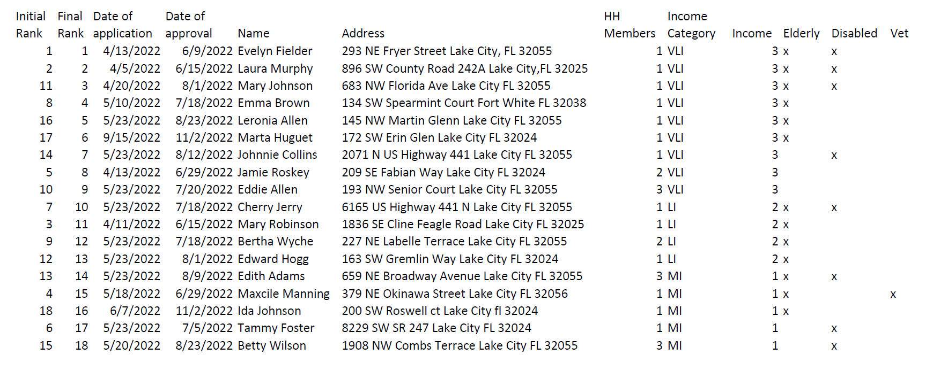
CDBG Housing Rehabilitation Program
Grant administrator for the Housing Rehab program, Guardian CRM, submits the following ranking sheet to be approved by the Board:
Recommended Motion: Approve the ranking sheet for CDBG Housing Rehabilitation Program

Slide 15
Residential Development Assistance Program
On April 2, 2020 the Board of Commissioners approved an economic development tax rebate incentive program for residential development
The program is scheduled to be re-evaluated for effectiveness after three years to determine feasibility of continuance
Program was intended to encourage developers to build “workforce” housing and was implemented before COVID pandemic.
Recommended Motion: Seeking Board Direction

Slide 16
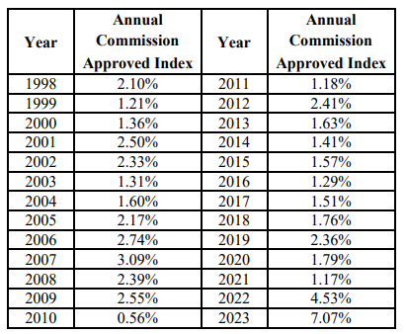
Resolution No. 2023R-17 2023 Price Index
Each year the County sets a Price Index for private investor owned utilities following the Public Service Commission's example provided to Staff
The Price Index allows for gradual rate increases based on inflation to avoid expensive rate cases and large rate jumps.
This Resolution sets the 2023 Price Index
Recommended Motion: Approve Resolution
No. 2023R-17 setting the 2023 Price Index at 7.07%

Slide 17
2023 Utility Price Index Adjustment College Manor Utilities
Request for 2023 Price Index Adjustment - College Manor Utilities
Monthly Base Charge from $21.28 to $23.66
Usage Charge per 1000 gallons from $2.12 to $2.36
Recommended Motion: Approve the Price Index Adjustment for College Manor Utilities

Slide 18
2023 Price Index Adjustment Lance Water
Request for 2023 Price Index Adjustment - Lance Water
Base Charge for ¾” from $31.77 to $35.02
Usage Charge from $7.76 to $8.55
Recommended Motion: Approve the Price Index Adjustment for Lance Water

Slide 19
Resolution No. 2023R-09 Water Rate Adjustments and Proposed Policies
The Fort White - Columbia County Utility Committee recommended having standardized rates for all the County operated utilities
The Committee recommended setting the Ellisville Residential water rates equal to the Fort White Residential water rates and gradually increasing the Ellisville Commercial water Rates until they reach the Fort White commercial rates
The new water rates in Ellisville:
Fort White rates will remain unchanged until October. The Town Council previously approved annual CPI increases each October.

Slide 20
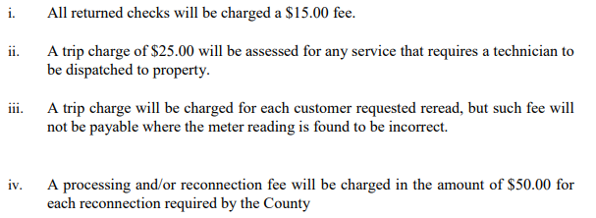
Resolution No. 2023R-09 Water Rate Adjustments and Proposed Policies
All water customers were sent notices of the proposed increase on March 1, 2023
In addition, staff is recommending policy adjustments and a single set of fees so the Utility has one set of policies for all customers

Slide 21
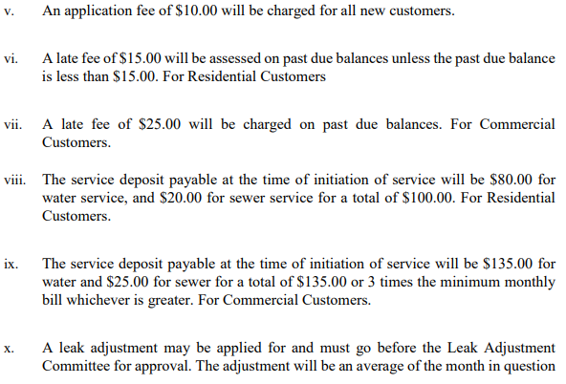
Resolution No. 2023R-09 Water Rate Adjustments and Proposed Policies

Slide 22
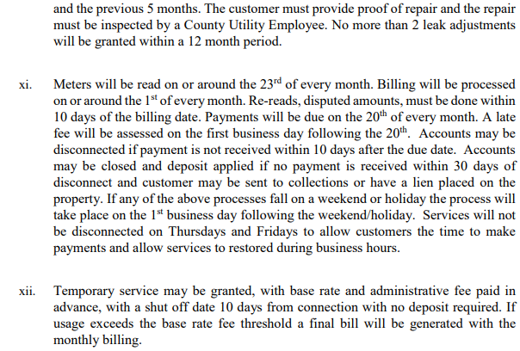
Resolution No. 2023R-09 Water Rate Adjustments and Proposed Policies

Slide 23
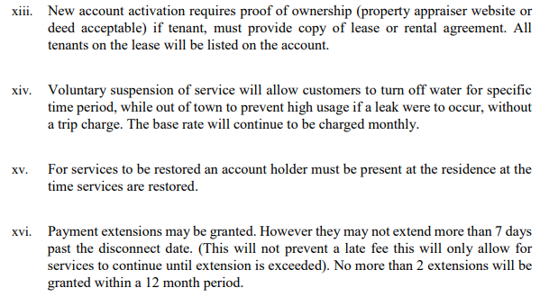
Resolution No. 2023R-09 Water Rate Adjustments and Proposed Policies

Slide 24
Resolution No. 2023R-09 Water Rate Adjustments and Proposed Policies
Recommended Motion: Approve Resolution No. 2023R-09

Slide 25
Resolution No. 2023R-09 Water Rate Adjustments and Proposed Policies
All water customers were sent notices of the proposed increase on March 1, 2023
In addition, staff is recommending policy adjustments and a single set of fees so the Utility has one set of policies for all customers
Recommended Motion: Approve Resolution No. 2023R-09

