Slide 1
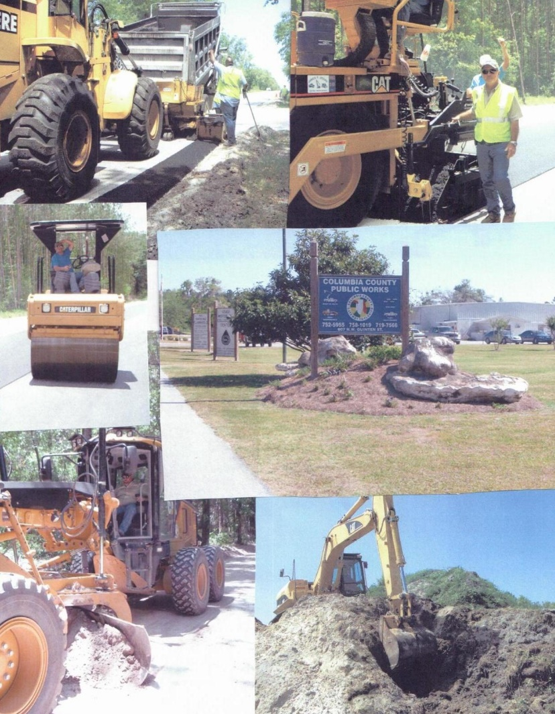
Board of County Commissioners Budget Workshop 2021-22 FY

Slide 2
Public Works 2021-22 Budget Request Summary
2020-21 2021-22
Budget Requested
TOTAL OPERATING BUDGET $ 8,491,685 $8,560,864
UNFUNDED CAPITAL PROJECT $ 142,500
GRAND TOTAL $8,703,364

Slide 3
Public Works 2021-22 Budget Request Changes
Line Item Description | 2020-21 Budget | 2021-22 Requested
Principal-Debt Service | $ 147,133 | $ 231,819
Interest-Debt Service | $ 40,037 | $ 66,397
Road Materials & Supplies | $ 465,000 | $ 475,000
Salaries/Sign Shop | $ 125,920 | $ 154,294
Repairs & Maintenance | $ 250,000 | $ 320,000
Operating Supplies | $ 2,000 | $ 5,000
Communication Services | $ 25,000 | $ 50,000
General Insurance | $ 270,000 | $ 280,000
Repairs & Maintenance | $ 14,000 | $ 17,000
Other Charges | $ 0 | $ 5,000
Operating Supplies | $ 5,000 | $ 7,500
Concrete Work | $ 85,000 | $ 105,000

Slide 4
Explanation of Budget Changes
Principal and interest will increase based on current leases.
Road materials remain the same but an additional $10,000 was added due to the increase in requests for speed humps.
Sign Shop Salaries and Benefits increase for the additional Signal Tech II position.
Repairs and Maintenance are increased $70,00 based on YTD 20/21 annualized.
Stockroom Operating Supplies increase $3,000 for potential storm supplies.
Communications will increase $25,000 based on actual for 20/21 annualized

Slide 5
Explanation of Budget Changes
General Insurance increased by $10,000 based on actual for 20/21 annualized
Repair and Maintenance will be used as building repairs are needed.
Other charges increase to cover accident claims.
Operating Supplies Admin increased by $2,500 is based on actual for 20/21 annualized.
Concrete Work increased to cover the increase in concrete projects.

Slide 6
Public Works Unfunded Capital Project 2021-22
Build equipment barn to prevent weather damage to equipment.
Estimated Cost--- $142,500

Slide 8
Public Works Departments/Employees
Road Maintenance 18 employees
Drainage 10 employees
Storm Water 9 employees
Sign Shop/Traffic Signal 3 employees
Fleet Maintenance 11 employees
Administration 7 employees
Mowing/Tree 13 employees
Right-of-Way Maintenance 12 employees
Engineering/Construction 3 employees

Slide 9
Public Works Funding Sources
County Gas Tax
Constitutional Gas Tax
Local Option Sales Tax
Voted Gas Tax
Fuel Decal User Fee
Motor Fuel Tax Rebate
State revenue Sharing
Fiscally Constrained County (Extra $.005 Sales Tax)
County Sales Tax ($.01)

Slide 10
Public Works Funding Sources
FDOT Lighting Reimbursement
Culvert Permit/Waiver Fees
Interest Earned
Reimbursements from other County Departments
Miscellaneous--- Recycling, Insurance Claims, etc.
Cash on hand

Slide 11
Public Works 2022 Budget Request
Line Item 2020-21 2021-22
Budget Requested
4210.541.30.34 Contract Mowing $234,000 $234,000
This item is budgeted through the Public Works Department, however it is administered by the Landscape and Parks Department.

Slide 12
Public Works 2022 Budget Request Road Maintenance
Line Item Description | 2020-21 Budget | 2021-22 Requested
Salaries/Road Maintenance | $ 567,546 | $ 541,424
Overtime | $ | $ 25,000
On Call Standby |  | $ 1,400
FICA Taxes | $ 43,417 | $ 41,419
Retirement Contributions | $ 59,868 | $ 54,142
Health/Life Contributions | $ 179,830 | $ 179,831
Workers’ Compensation | $ 48,383 | $ 46,725
Rentals & Leases | $ 500 | $ 500
Repairs & Maintenance | $ 0 | $ 0
Other Charges | $ 0 | $ 0
Operating Supplies | $ 2,000 | $ 2,000
Equipment Purchases | $ 0 | $ 0
Principal-Debt Service | $ 147,133 | $ 231,819
Interest-Debt Service | $ 40,037 | $ 66,397
TOTALS | $ 1,088,714 | $ 1,190,657

Slide 13
Public Works 2022 Budget Request Drainage
Line Item Description | 2020-21 Budget | 2021-22 Requested
Salaries/Road Maintenance | $ 295,418 | $ 284,398
Overtime | $ | $ 2,500
On Call Standby | $ | $ 1,400
FICA Taxes | $ 22,599 | $ 21,756
Retirement Contributions | $ 31,913 | $ 28,440
Health/Life Contributions | $ 99,906 | $ 99,906
Workers’ Compensation | $ 25,494 | $ 24,544
Other Charges | $ 500 | $ 500
Operating Supplies | $ 5,500 | $ 5,500
Road Materials & Supplies | $ 465,000 | $ 475,000
Non-Capital Equipment | $ 0 | $ 0
Equipment Purchases | $ 0 | $ 0
TOTALS | $ 946,330 | $ 943,944

Slide 14
Public Works 2022 Budget Request Storm Water
Line Item Description | 2020-21 Budget | 2021-22 Requested
Salaries/Storm Water | $ 239,866 | $ 232,918
Overtime | $ | $ 4,600
On Call Standby | $ | $ 1,400
FICA Taxes | $ 18,349 | $ 17,818
Retirement Contributions | $ 22,712 | $ 23,292
Health/Life Contributions | $ 89,915 | $ 89,915
Workmans Compensation | $ 20,574 | $ 20,101
Professional Services | $ 3,000 | $ 3,000
Rentals & Leases | $ 0 | $ 0
Other Charges | $ 500 | $ 500
Operating Supplies | $ 6,000 | $ 6,000
Road/Construction Supplies | $ 10,000 | $ 10,000
Non-Capital Equipment | $ 0 | $ 0
Equipment Purchases | $ 0 | $ 0
TOTALS | $ 410,916 | $ 409,544

Slide 15
Public Works 2022 Budget Request Signs/ Traffic Signals
Line Item Description | 2020-21 Budget | 2021-22 Requested
Salaries/Sign Shop | $ 125,920 | $ 154,294
Overtime | $ | $ 4,000
On Call Standby | $ | $ 14,000
FICA Taxes | $ 9,632 | $ 11,804
Retirement Contributions | $ 12,592 | $ 15,429
Health/Life Contributions | $ 29,971 | $ 49,953
Workmans Compensation | $ 10,613 | $ 13,316
Contractual Services | $ 10,000 | $ 10,000
Communication Services | $ 11,400 | $ 0
Utilities | $ 115,000 | $ 115,000
Other Charges | $ 0 | $ 0
Operating Supplies | $ 150,000 | $ 105,000
Non-Capital Equipment | $ 0 | $ 0
Equipment Purchase | $ 0 | $ 0
TOTALS | $ 577,056 | $ 492,796

Slide 16
Public Works 2022 Budget Request Fleet Maintenance
Line Item Description | 2020-21 Budget | 2021-22 Requested
Salaries/Fleet Maint. | $ 327,580 | $ 313,768
Overtime | $ | $ 3,000
On Call Standby | $ | $ 1,225
FICA Taxes | $ 25,059 | $ 24,003
Retirement Contributions | $ 32,758 | $ 31,377
Health/Life Contributions | $ 99,906 | $ 99,906
Workmans Compensation | $ 17,188 | $ 7,468
Repairs & Maintenance | $ 250,000 | $ 320,000
Other Charges | $ 500 | $ 500
Operating Supplies | $ 45,000 | $ 45,000
Non-Capital Equipment | $ 0 | $ 0
Equipment Purchases | $ 0 | $ 0
TOTALS | $ 797,991 | $ 846,247

Slide 17
Public Works 2022 Budget Request Stockroom
Line Item Description | 2020-21 Budget | 2021-22 Requested
Salaries/Stockroom | $ 27,289 | $ 27,290
FICA Taxes | $ 2,087 | $ 2,088
Retirement Contributions | $ 2,728 | $ 2,729
Health/Life Contributions | $ 9,990 | $ 9,991
Workmans Compensation | $ 2,358 | $ 2,355
Operating Supplies | $ 2,000 | $ 5,000
Gasoline & Oil Charges | $ 448,000 | $ 448,000
TOTALS | $ 494,452 | $ 497,453

Slide 18
Public Works 2022 Budget Request Administration
Line Item Description | 2020-21 Budget | 2021-22 Requested
Salaries/Administration | $ 554,277 | $ 525,685
Overtime | $ | $ 20,000
FICA Taxes | $ 42,402 | $ 40,213
Retirement Contributions | $ 74,891 | $ 61,018
Health/Life Contributions | $ 89,915 | $ 89,915
Workman’s Compensation | $ 21,313 | $ 736
Professional Services | $ 140,000 | $ 140,000
Contractual Service | $ 0 | $ 0
Administrative Fees | $ 335,478 | $ 335,478
Travel & Per Diem | $ 1,000 | $ 1,000
Communication Services | $ 25,000 | $ 50,000
Utilities | $ 23,000 | $ 23,000

Slide 19
Public Works 2022 Budget Request Administration
Line Item Description | 2020-21 Budget | 2021-22 Requested
Rentals & Leases | $ 2,500 | $ 2,500
General Insurance | $ 270,000 | $ 280,000
Repairs & Maintenance | $ 14,000 | $ 17,000
Printing/Legal Ads | $ 3,000 | $ 3,000
Advertising | $ 0 | $ 0
Wildlife Control | $ 50,000 | $ 50,000
Other Charges | $ 0 | $ 5,000
Office Supplies | $ 10,000 | $ 10,000
Operating Supplies | $ 5,000 | $ 7,500
Subscription & Dues | $ 200 | $ 200
Non-Capital Equipment | $ 0 | $ 0
Equipment Purchases | $ 482,000 | $ 396,913
TOTALS | $ 2,143,976 | $ 2,059,131

Slide 20
Public Works 2022 Budget Request Road R/W Maintenance
Line Item Description | 2020-21 Budget | 2021-22 Requested
Salaries/Road R/W Maint. | $ 411,787 | $ 392,621
Overtime | $ | $ 12,000
On Call Standby | $ | $ 19,775
FICA Taxes | $ 31,502 | $ 30,035
Retirement Contributions | $ 41,179 | $ 39,262
Health/Life Contributions | $ 129,878 | $ 139,868
Workmans Compensation | $ 34,540 | $ 33,883
Contractual Services | $ 172,500 | $ 172,500
Repairs & Maintenance | $ 30,000 | $ 30,000
Other Charges | $ 0 | $ 0
Operating Supplies | $ 25,000 | $ 25,000
Non-Capital Equipment | $ 0 | $ 0
Equipment Purchases | $ 0 | $ 0
TOTALS | $ 876,386 | $ 894,944

Slide 21
Public Works 2022 Budget Request Shoulder Operation
Line Item Description | 2020-21 Budget | 2021-22 Requested
Salaries/Shoulder Oper. | $ 343,032 | $ 333,837
Overtime | $ | $ 6,300
On Call Standby | $ | $ 1,400
FICA Taxes | $ 26,241 | $ 25,539
Retirement Contributions | $ 34,303 | $ 33,384
Health/Life Contributions | $ 119,887 | $ 129,878
Workmans Compensation | $ 28,623 | $ 28,810
Operating Supplies | $ 8,000 | $ 8,000
Equipment Purchases | $ 0 | $ 0
TOTALS | $ 560,086 | $ 567,148

Slide 22
Public Works 2022 Budget Request Miscellaneous
Line Item Description | 2020-21 Budget | 2021-22 Requested
Road Striping | $ 100,000 | $ 100,000
Dust Suppressant | $ 0 | $ 0
Concrete Work | $ 85,000 | $ 105,000
Road Stabilization | $ 165,000 | $ 165,000
Weed Control | $ 55,000 | $ 55,000
Millings | $ 0 | $ 0
TOTAL | $ 405,000 | $ 425,000

