Slide 1
Board of County Commissioners
Regular Meeting
February 1, 2024
9:30 p.m.
Columbia County School Board Administrative Complex

Slide 2
2023-11 - SW English St. and LM Aaron Dr. Roadway Construction
The County received two (2) bids for the above referenced solicitation.
Recommended Motion: Award Bid No. 2023-11 to Curt’s Construction, Inc. for the total bid amount of $1,743,364.02 and to approve the Agreement.
Company Name | Bid Amount
Anderson Columbia Co. | $2,528,244.58
Curt’s Construction, Inc. | $1,743,364.02

Slide 3
2024-A - Traffic Stripe Painting - Jenkins Painting - $658,161
The County received two (2) bids for the above referenced solicitation.
Recommended Motion: Award Bid No. 2024-A to Jenkins Painting for the total bid amount of $658,160.96 and to approve the Agreement.
Company Name | Bid Amount
Jenkins Painting | $658,160.96
Emerald Coast Striping, LLC. | $910,079.84

Slide 4
Board of County Commissioners
Regular Meeting
February 1, 2024
9:30 AM
Columbia County School Board Administrative Complex

Slide 5
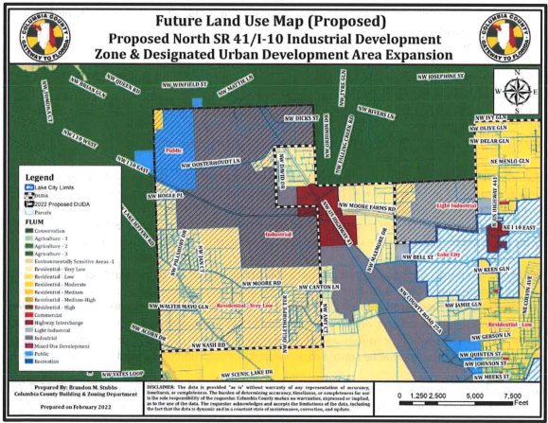
Request to Set Second Public Hearing Expansion of Designated Urban Development Area (DUDA)
Set the date for the second hearing for the expansion of the DUDA at the I-10 interchanges for March 21, 2024
Recommended Motion: Approve the public hearing for the expansion of the DUDA at the 1-10 Interchange for March 21, 2024

Slide 6
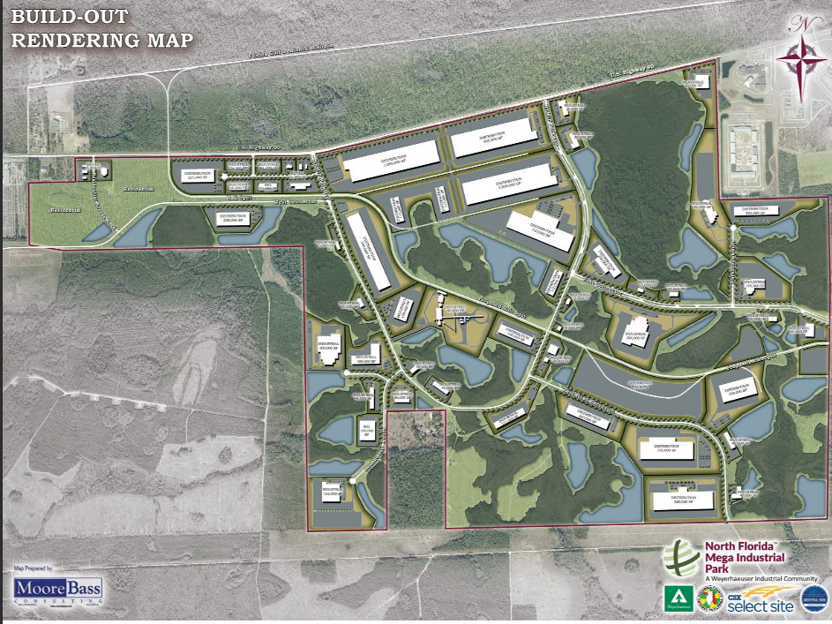
Request to Set Adoption Hearing Municipal Service Taxing Unit (MSTU) North Florida Mega Industrial Park
Set date for adoption hearing for a Municipal Service Taxing Unit to fund the provision of public infrastructure in the North Florida Mega Industrial Park on March 21, 2024
Recommended Motion: Approve the public hearing date for the adoption of a MSTU for March 21, 2024

Slide 7
Spending Plan Florida Opioid Allocation Settlement
Department of Children and Families has contracted with LSF Health Systems as the Managing Entity for the Florida Opioid Allocation Settlement
Columbia County is one of 47 counties who are designated as a "non-qualified" county that will receive funding through the opioid abatement funds
LSF solicited the County to provide a plan to expend the settlement funds that will extend for 17 years.
LSF will contract with the County to administer programs in the plan
County has identified programs to address opioid concerns in Columbia County
Recommended Motion: Approve the submission of the spending plan

Slide 8
Spending Plan Florida Opioid Allocation Settlement
Family Support Services - NorthStar Family Resource Center - $108,680
family and community support and prevention efforts, community education, hand-offs to substance abuse and medical experts, and programs to help reduce the stigma associated with seeking help for substance abuse issues
Community Paramedicine - Columbia County Fire and Rescue - $320,421
Mobile vehicle with State certified Paramedic, medications and medical supplies to respond to opioid abuse incidents
Hospital Bridge Program - Meridian Behavioral Healthcare System - $222,000
engage clients in the hospital to utilize services provided by Meridian for substance use disorders (including opioid use/overdose) and other complications from substances.
Drug Awareness Education - Columbia County Sheriff - $106,000
Educate elementary students in the prevention of opioid use and provide 1 full-time Licensed Substance Abuse Counselor at the Detention Center to provide counseling, support and resources to inmates who are incarcerated with opioid abuse.

Slide 9
Side Track Rail Agreement
Agreement to have Florida Gulf & Atlantic operate trains and rail equipment on the rail spur (Sidetrack) and provide such other rail related services as are customary in the rail transportation business
The county's rail consultant worked directly with FG&A while advising both county attorney and economic development staff to create the draft which is standard operating procedure within the railroad industry
Recommended Motion: Approve the SOP side track agreement between Columbia County and Florida Gulf & Atlantic Railroad

